Slide 1
Final project –
[Naive Bayes Classifier]
Instructor: Senjuti Basu Roy
Present by/student: li-jung chen ,Li chen

Slide 2
Abstraction
Objective:
  Implement Naive Bayes Classifier from scratch
  Predict if a person makes over 50K a year, from the data set given.
Solution Highlights
Dataset Description
Result
  Objective result
  Combine graph
  70-30 Training-Testing result
Problems and Solution
Conclusion

Slide 3
Solution Highlights
Bayes theorem
Gaussian distribution for Continuous data probability calculation
Functions:
  Gaussian Probability (x, mean, stdev)
  Naive_Bayse (X_train, Y_train,X_test,Y_test, pos_label)
API:
  Pandas for reading CVS file
  Math and Statistic package for Gaussian distribution
  Sklearn for computing accuracy, precision and recall score
  Time for computing time taken of the algorithm

Slide 4
Dataset Description
 | adult.data | adult.test
Number of dataset (before cleaning) | 32561 | 16281
Number of dataset (after cleaning) | 30162 | 15060
All Files | Total Number :45,222 | Discard Number :3,620
Data class distribution | 24.78% >50k | 75.22% <=50k
URL: https://archive.ics.uci.edu/ml/datasets/adult
age | workclass | fnlwgt | education | education-num | marital-status | occupation | relationship | race | sex | capital-gain | capital-loss | hours-per-week | native-country | label
39 | State-gov | 77516 | Bachelors | 13 | Never-married | Adm-clerical | Not-in-family | White | Male | 2174 | 0 | 40 | United-States | <=50K
50 | Self-emp-not-inc | 83311 | Bachelors | 13 | Married-civ-spouse | Exec-managerial | Husband | White | Male | ? | 0 | 13 | United-States | <=50K
38 | Private | 215646 | HS-grad | 9 | Divorced | Handlers-cleaners | Not-in-family | White | Male | 0 | 0 | 40 | United-States | >50K
  Number of Attributes: 14
  Label: <=50k and >50k
  Number of Continuous Attributes: 6
  Number of Categorical Attributes: 8

Slide 5

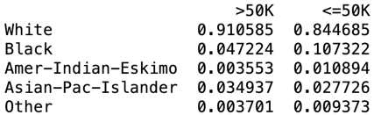
Codes implementation
Input the organized dataset into the function
Compute the probability and critical values table for each class attributes
Compared the Bayes theorem probability. Output the greater probability label as the prediction
Collect the information and compute the accuracy and other results.
Continuous data | Categorical data

Slide 6
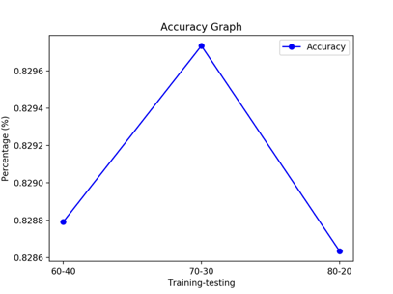
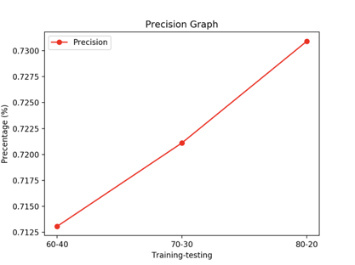
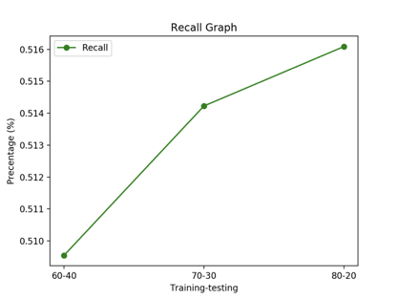
Result-1 objective result
Training- Testing | 60-40 | 70-30 | 80-20 | Average
Training Time: | 2.7 sec | 3.3 sec | 3.06 sec | 3.02 sec
Testing Time: | 101.4 sec | 76.5 sec | 52.0 sec | 76.6 sec
Accuracy: | 82.9% | 83.0% | 82.9% | 82.9%
Precision: | 71.3% | 72.1% | 73.1% | 72.2%
Recall: | 51.0% | 52.4% | 51.6% | 51.7%

Slide 7
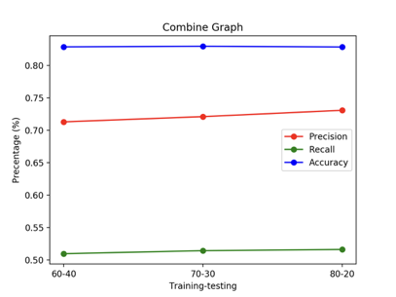
Result-2 combine graph
The best result comes from the split 70-30 based on the accuracy result

Slide 8
Result-3 70-30 Confusion matric
Training Data | Predict >50k (1) | Predict <=50k (0) | Total
Actual >50k (1) | 3868 | 3966 | 7,834 | Recall: 49.4%
Actual <=50k (0) | 1656 | 22165 | 23,821
 | Precision: 70% |  | Accuracy: 82.2% | Total number:31,646
Testing Data | Predict >50k (1) | Predict <=50k (0) | Total
Actual >50k (1) | 1735 | 1639 | 3,374 | Recall: 51.4%
Actual <=50k (0) | 671 | 9522 | 10,193
 | Precision: 72.1% |  | Accuracy: 83.0% | Total number: 13,567
This indicated that our algorithm does not over fitting

Slide 9
Problems & solution
Difficulty
  Zero-Probability problem: some classes only result one class label. The total probability will become zero no matter how the other attributes performed.
  Unseen class encountered in the testing phase: testing data contain new unique class of attributes that were untrained by the model.
Solution
  Add 1 to each case, return back to the current attributes and calculate the probability again to solve the problem.
  Ignore that attributes in the end probability calculation.

Slide 10
Conclusion
This project was consolidated by the efforts of both team members
Learned:
  Naïve Bayes Algorithm was deeply understood
  Mixed types data should treat differently in the algorithm, Gaussian for continuous data, Bayes theorem for Categorical data. The calculation was done separately and merge at the end to determine the final prediction.

